Slide 1
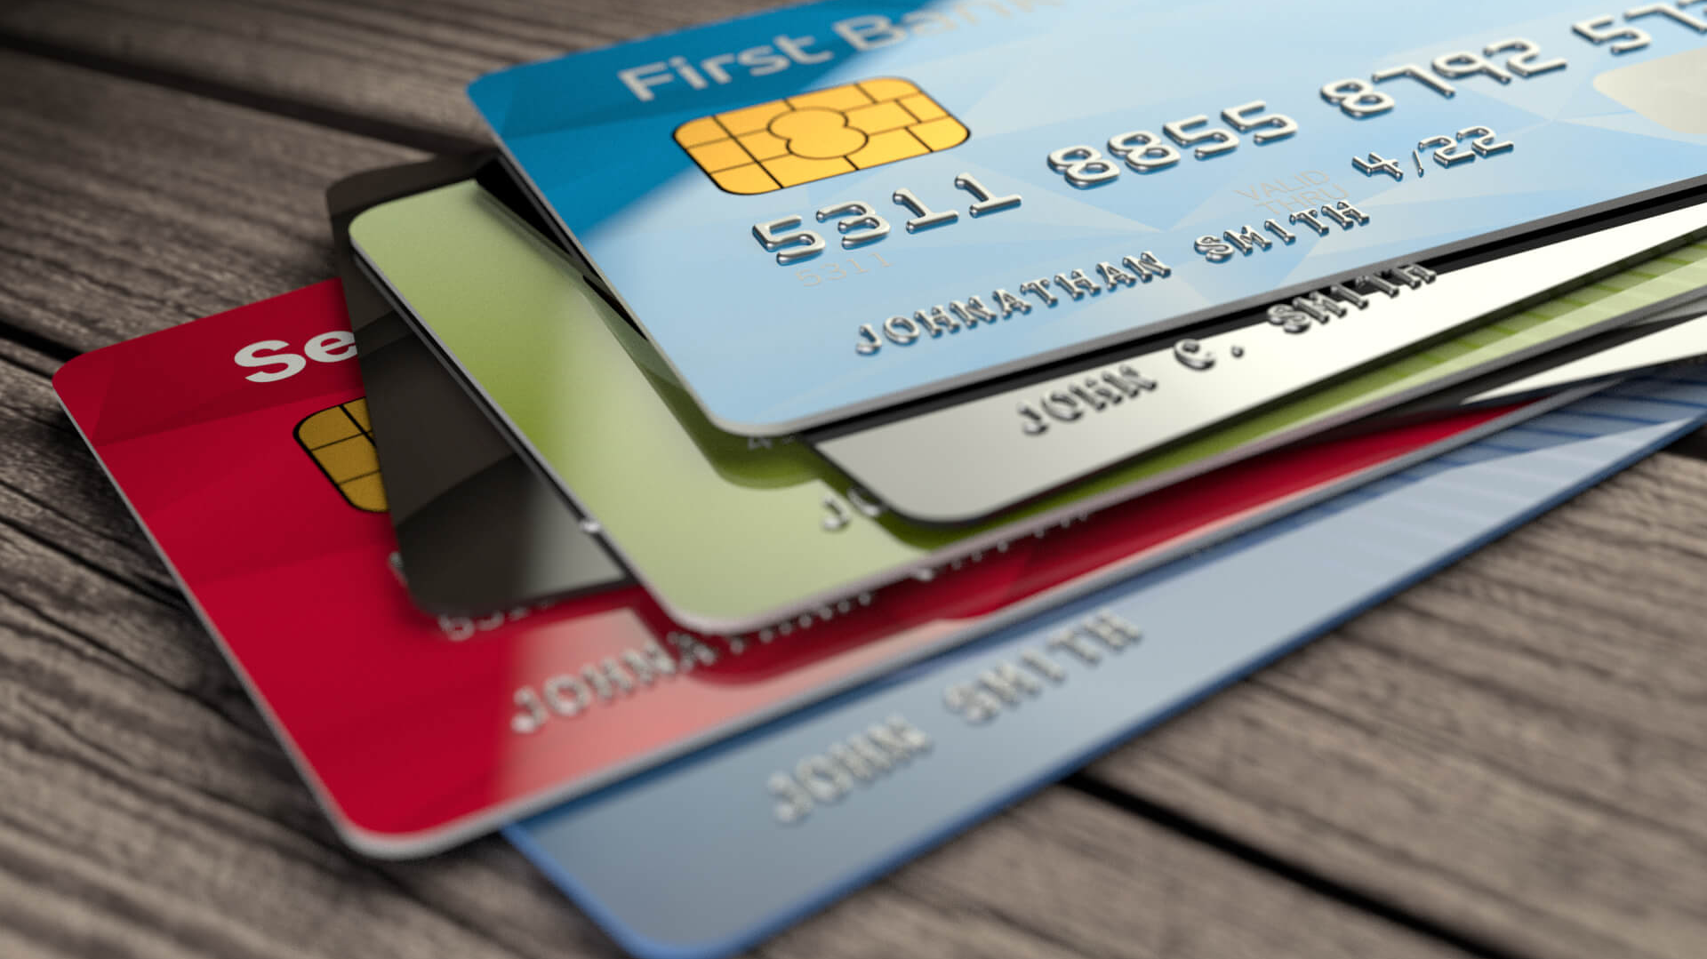
CREDIT CARD
By VANDANA C V
Emp ID:46133800
CAPGEMINI

Slide 2
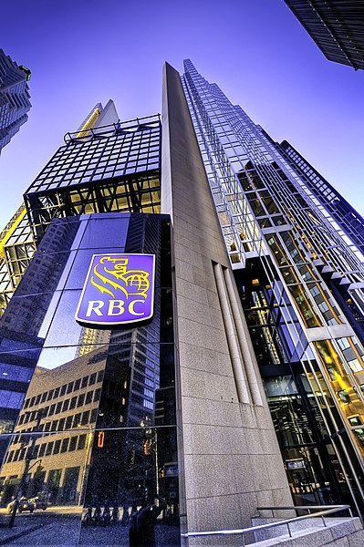
AGENDA
Team Structure
Credit Card Life Cycle
Terminologies
Credit Card fees
TSP, Transaction & Authorization
Types Of Cheques
Credit Card Understandings
Reward Strategies & Billing
This Photo by Unknown author is licensed under CC BY-SA.

Slide 3
We Are..
We are a team of 32 members working on Credit Cards operation for the Royal bank of CANADA.
Out of 32, we have 27 resources with 2 manager and 3 testing lead
Janet is our Project manager and Shree Kanth is our Offshore Manager

Slide 4
We Do..
We perform REGRESSION TESTING for 2 application every month.
We perform Project program 3 months which require 1 to 2 person for 1 to 2 month
Change request for 4 to 5 months

Slide 5
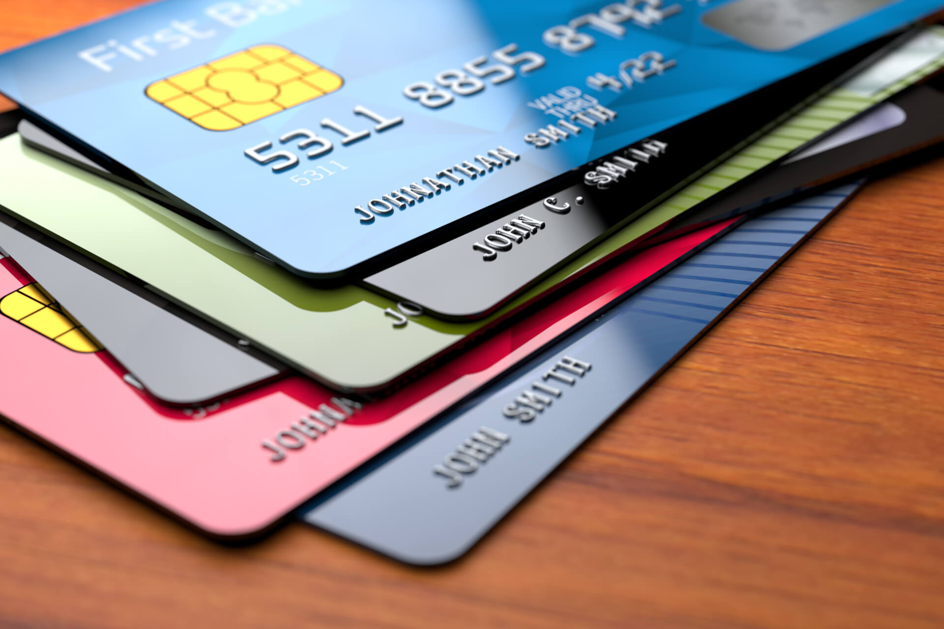
Introduction to Credit Card
A credit card is a payment card issued to users to enable the cardholder to pay a merchant for goods and services based on the cardholder's accrued debt. The card issuer creates a revolving account and grants a line of credit to the cardholder, from which the cardholder can borrow money for payment to a merchant or as a cash advance. There are two credit card groups: consumer credit cards and business credit cards. Most cards are plastic, but some are metal cards, and a few gemstone-encrusted metal cards.

Slide 6
Credit Card Life Cycle
PRESALES AND SALES
ORIGINATION
ADJUDICATION
FULLFILLMENT
SERVICING
PORTFOLIO MANAGEMENT

Slide 7

Presales And Sales
Credit card market trends include the growing technological innovation. Major corporations are concentrating on offering digital prepaid card services in emerging economies to attract a large consumer base for a prepaid credit card.
Which include Prospectus containing details and functionalities of the card
Global credit card market segments include:
1) By Type: Reward Card, Credit Builder Card, Travel Credit Card, Balance Transfer Card, Others.
2) By Card Type: Base, Signature, Platinum.
3) By Service Provider: Visa, Mastercard, RuPay, Others.

Slide 8
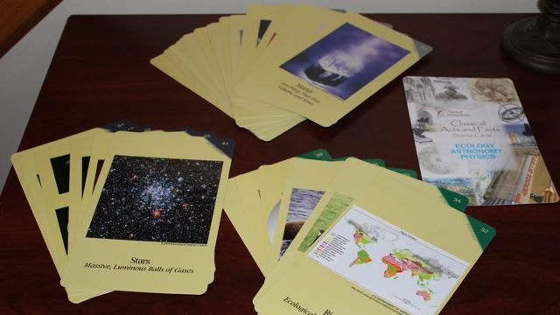
Origination
We have 4 region By Geography: The market is segmented into Cannada consumer(2430), Cannada Commercial(8880), U.S Consumer(3357) and Carrabine(8947)
Here we take the details of the consumer which include name, city, DOB and other personal details in order to generate the customer id for further process
We have 4 ways for Credit Card generation in COSM QA
OLB (online banking)-here one can apply for Credit Card, but the user does not have provision to create the account
Casper- it is a web application used to origin Credit card.
Originate IAO- AKA Originate Instant Account Open which provide user control.
TS2/TSYS application- Origination through Application.
This Photo by Unknown author is licensed under CC BY-NC-ND.

Slide 9
ADJIDICATION
Adjudication refers to the process of a neutral third-party reviewing evidence and arriving at a decision to settle a conflict or court case.
It is a process where identifying the customer is legally eligible
This process is handled by the production region (P- Region)

Slide 10
Fullfillment
FULFILLMENT include
fulfilling their needs and requirements
Activation of the card
Providing Card to the customer
Generation of 4-digit pin

Slide 11

Servicing
Managing the customer activity which is done by financial company
Fixing issues and rising requests by customer
Renewal of card, Block the card, illegal usage, Transaction issues
Providing Customer satisfaction by providing on time response
Quality servicing

Slide 12
Portfolio Management
Portfolio management is an art and science of making decisions about matching investments to objectives, asset allocation to individuals and balancing risk against performance.
It is a key skill that one requires for managing investment effectively
It is the are of selecting the right investment tool in the right proportion to generate optimum returns with a balance of risk from the investment made.
The major objective of portfolio management are
Capital growth
Diversification of Risk
Consistant Planning

Slide 13
Pros & Cons
PROS
A credit card is safer than carrying cash
A credit card can build your credit rating
You can get interest-free days
Earn rewards points when you spend
Request a chargeback if you’re unhappy with a product or service.
Credit cards work in any currency.
Credit cards give you an emergency line of credit.
Travel reservations and insurance
You can make online purchases.
CONS
Paying high rates of interest.
Credit damage
Cash advance fees and rates
Annual fees
Credit card surcharges
Other fees can quickly add up
Overspending.

Slide 14
Some more information
SYMCOR-It is a third-party vendor which sends STATEMENTS to RBC credit card holder​
GEMALTO/THALES- A third vendor which manufacture and personalize the functions of Debit and Credit Card Processing.
WEB IR- Web based application by Symcor which is used to authorize the credit card cheques or convenience cheques.
ERNEX- It is a third-party vendor that takes care of the reward points for RBC.
CCSA(Credit Card Servicing Application)-it’s a web-based application that overlays the current credit card processing system known as TS2
TS2-Is an integral option-driven Processing system used to manage card portfolios and serve customers.

Slide 15
Credit Card Terminologies
Annual percentage rate (APR) refers to the yearly interest generated by a sum that's charged to borrowers or paid to investors. APR is expressed as a percentage that represents the actual yearly cost of funds over the term of a loan or income earned on an investment.
credit limit also known as a credit line, is the maximum amount of money you can borrow under a revolving credit agreement
Available credit is the difference between the total credit limit and the amount that the borrower has accumulated through their purchases
outstanding balance is the amount you owe on any debt that charges interest.
cash advance on your credit card is an amount of cash borrowed against your credit limit.
Credit bureau a company which collects information relating to the credit ratings of individuals and makes it available to banks, finance companies, etc.
grace period is the number of days between a consumer’s credit card statement date and payment due date when interest does not accrue.
credit score is a statistical number that evaluates a consumer's creditworthiness and is based on credit history.
Due date-is the date by which you need to pay your credit card outstanding every month.
Past due-When an account is considered past due, that means the minimum required payment was not applied to the account as of the last payment due date.
Minimum payment-It’s the minimum payment done in order to escape from PD

Slide 16
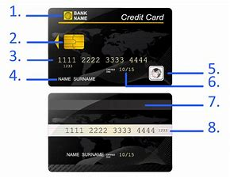

Credit Card Anatomy
9
Issuing bank logo
EMV chip-An EMV chip is an embedded microprocessor chip in payment cards such as credit and debit cards which stores and protects cardholder data
Card number-A credit card number is the unique number imprinted on a credit card. The first six digits on a credit card are called the issuer identification number.
Card holder name
Hologram- The holograms found on credit cards are made up of several layers of images taken at different angles and stacked on top of one another.
Validity date
Magnetic Strip:-The "stripe" contains embedded information that identifies its user
Card security code-A card security code (CSC; also known by several other names) is a series of numbers that, in addition to the bank card number, is embossed or printed on a card.
Contactless chip-Contactless payment systems are credit cards and debit cards, key fobs, smart cards, or other devices, including smartphones and other mobile devices, that use radio-frequency identification (RFID) or near-field communication

Slide 17
Credit Card Fees
Annual fee-Usually, you’ll only run into annual fees with premium credit cards that offer extra benefits like rewards and cash back, as well as other perks like a strong insurance package, entertainment extras and airport lounge access.
Cash advance fee-When you use your credit card to withdraw cash from an ATM called a cash advance, some credit card providers will charge a small cash advance fee
Over-the-limit fees-It’s your responsibility to ensure you stay within your credit limit. If you do go over your limit you may be charged an over-the-limit fee
Balance transfer fee-Some credit cards will allow users to transfer a balance from another credit card for a fee.
Late payment fees-While some credit card companies may charge a late payment fee
Extra card fees-fee for providing extra card
Fast card fee

Slide 18
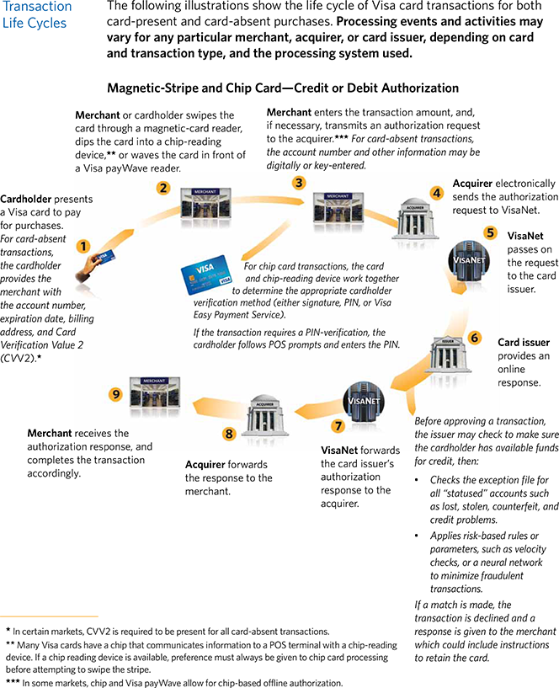
Transaction And Authorization

Slide 19
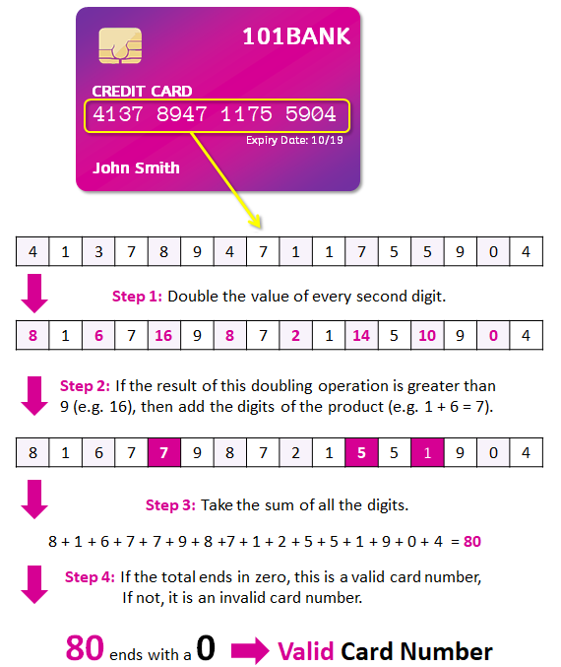
Luhn's Algorithm

Slide 20
Transaction Special Protocol(TSP)
We have 2 parts
TBAL-Purchase, Cash Advance, Special Transaction
TCAT- Purchase, Fees

Slide 21
Types Of Cheques
Bearer Cheque- Bearer cheques are usually used for cash transactions and are withdrawn by the individuals carrying the cheque and presenting it to the bank.
Order Cheque -it is the cheque which becomes payable to the person or organization whose name is specified on the cheque or to his order.
Cross Cheque-A crossed cheque is basically any cheque which is crossed with two parallel lines. The lines can be drawn either across the whole cheque or through the top left-hand corner.
Post-dated Cheque-If a cheque bears a date which is yet to come (future date) then it is known as post-dated cheque.
Stale Cheque-A Stale Check is defined as a check that is presented to the bank after a considerable amount of time from the date that has been mentioned on the check.
Self Cheque-Self-cheques are encashed from the branch where you have a bank account.
Banker Cheque-A banker’s cheque similar to a banker’s draft is guaranteed by the bank.

Slide 22
Drafter File Creation
On-us transaction-A transaction carried out at an ATM of the card issuing bank is called as On-Us transaction
Off-us transaction-off-us txn means that the bank that issue your card is the different as the one which owns the ATM or POS terminals on which you made txn
RBC-RBC Transaction
RBC-Other Transaction

Slide 23
Adjustment & Reversal
Adjustment-Toast allows you to adjust the total amount for already completed credit card transactions in order to compensate for orders that need to be adjusted appropriately ONLY IF the credit cards have not been processed at the end of night batch process. This will allow you to increase the charge or decrease the charge on a credit card transaction.
Reversal-A payment reversal is a situation in which funds from a transaction are returned to the cardholder's bank account. A payment reversal can be carried out by several different methods and can be initiated by a cardholder, merchant, acquiring or issuing bank, or the card network.
A few examples that could lead to a transaction being overturned:
The merchant requested the wrong dollar amount when submitting a transaction.
The transaction was accidentally processed more than once.
The product description was misleading or inaccurate.
The item purchased is backordered or out of stock.
The customer decided against the item after ordering.
The customer is trying to get something for free.

Slide 24
Commercial And Caribbean Card
Commercial card-A commercial card is a credit card issued by employers for their employees to use to make purchases on behalf of their company. Frequently issued as co-branded cards with retailers, commercial cards help businesses manage their expenses by collecting all charges made by employees into a single place. When employees have to make purchases on behalf of their employer, they can use a commercial card so they’re not spending their own money. Commercial cards are frequently used by companies to keep track of such expenses in order to more closely analyze the effects on the company budget.
Caribbean Card-Caribbean offers the Royal Caribbean Visa Signature® card for its most loyal customers. With a $0 annual fee, this card helps you earn points through the MyCruise rewards program that you can redeem toward your next cruise or for onboard credit. Unlike most airline and hotel credit cards, however, this cruise-line card lacks any real loyalty benefits

Slide 25
Reissue, Replacement Card
REISSUE of card-Means the Bank will provide the credit card when the card gets expired.
Card Number will not change.
Expiry date will change.
Free of cost.
REPLACEMENT OF Card- Means the customer asks for another card when the card is stolen or lost or needs some upgrade.
Card number will change.
Expiry date will change.
Fees will be charged.

Slide 26
Balance transfer
Balance Transfer-It is the transfer of funds from one to another card within one's own Credit Card.
Why it is done?
Due date issue
Interest rate.
Promotional offer.
Additional Benefits.
Advantage to the bank is
New customer
Loyalty of customer
Additional account
Credit balance can be transferred (apply fees)
Additional benefits

Slide 27

Balance Protector
It acts as an insurance for credit card where certain percentage of balance will be added as Balance Protector.
Why should one pay??
When a customer loses his/her job or suffers from serious illness or death the insurance provider will pay a certain sum of money after the investigation is done.
How long the insurance provider will pay depends on the plan opted by the customer
This Photo by Unknown author is licensed under CC BY-ND.

Slide 28
Consumer Statement
Header section
Transaction section
Reward section
Payment & Interest section
Calculating section
Remit Slip section

Slide 29
Concept Of Payment& Payment Allocation
Previous Balance-Any previously due balance, that has not been paid, will be included with your total amount due for the following month.
Min. Payment-The minimum monthly payment is the least amount of money a borrower can pay on a revolving credit account each month and still remain in good standing with a credit card company.
Current Balance-Current balance is often a bigger amount that includes all funds including those that may be on hold, are still uncollected and thus, restricted by the bank from being used by the person holding the account
Fixed Payment-In a fixed-rate payment, the total amount due remains the same throughout the life of the loan, although the proportion that goes to interest and principal varies.
Automatic Payment-When you make an automatic payment, you’re telling your bank to transfer money on a set date and for a set amount, to pay a bill.

Slide 30
Option Set, Delinquency, Collections & Correspondence
ABP is a product of RBC used for REWARD
MCP is a product of RBC used for CASHBACK.
We have list of option
Authorization option set
Collection option set
Minium Payment option set
Delinquency Credit card delinquency occurs when a cardholder falls behind on making required monthly payments. While being 30 days late is generally considered delinquent, it typically takes two months of delinquent payments before the information is reported to credit reporting agencies.¹If an account is reported delinquent, then the event can have a negative effect on your credit score and curtail your ability to borrow in the future. However, once you have a thorough understanding of delinquency, dealing with it is actually quite straightforward.
Collections-If your debt is unsecured, such as credit card debt, and you default on your payments with that debt sent to collections, the credit card company would stop trying to collect the debt from you. Instead, the collections company that your debt was sent to, would pursue the debt and try to collect money from you.
Correspondence- Is sending letters to the customers regarding interest rate variations and more

Slide 31
Discloser Group, Pricing, Account Status
A Discloser group is a group where all info of a particular group is contained also mean a collection of option set
Pricing-This method of pricing works on a tiered qualification system. Typically, the merchant service provider will divide transactions into several classifications or “buckets” and charge a transaction rate for each tier. You may see tiers listed in several ways. For example, some merchant services divide their tiers into various qualification levels. As such, Qualified transactions might be charged at a rate of 1.XX, Mid-Qualified at 2.XX% and Non-Qualified at 3.XX%.
Account Status-The "Status of Accounts" section is viewed by lenders so they can assess your creditworthiness. It also enables them to determine how high (or low) a lending risk you are and how high (or low) your loan interest rate will be
We have 2 characters denoting the account status example PD(past due), CR(Credit Revoke), CL(Closed account), CO(Change Off)Neutral Status, Bad status

Slide 32
Interest Calculations
Simple interest-PNR/100
Annual percentage rate(APR)
Period Rate- APR/365
Average Daily Balance
Transaction amount
Finance Charge-(ABD*PR*BD)/100
ABD-(transaction amount*No of days transaction stayed)/BD
Billing days(BD)
No of days transaction stayed in cycle

Slide 33
Epsilon, TLP & Credit Point
Epsilon and TLP are the two application for AWARD and REWARD offered for the customer for their Loyalty part
There are 3 types
Reward- Customer gets rewards and offers for making their purchase
Cashback-Customer Gets awarded be sum of cashback for making their purchase.
Co-brand-customer Gets some percent of amount off by making a transaction only with the co-brands (ex: Pacific Airline, British airline)
Credit Point- is you’re earning rewards at a set rate per dollar you spend. The rate of points you earn may differ depending on the type of purchase you make. Some credit card issuers have a fixed points system

Slide 34
TRIAD Strategies
It is an Adaptive controlling system having several Strategies such as
Collection Strategies-If an account goes to PD or over limit COL will Trigger.
Proactive Limit Increment(PLI)-increase credit limit by a bank (Need to cycle)
Reactive Limit Increment (RLI)- A customer asks for increase in credit limit( No need of cycle)
Transaction Level Authorization(TLA)- It is an immediate trigger
Pricing-we have 2 types of pricing
Upward pricing is when a customer miss payment in any 12 months then the account rate will increase
Downward pricing is taking upward pricing and make 6 concecutive payment then the account rate will decreases

Slide 35
100% Billing / Forced Billing
If RBC wants to send some information through statement then 100% billing will be generated where every customer will receive the statement
When a customer has more than 1$ outstanding Balance then they will receive a statement

Slide 36
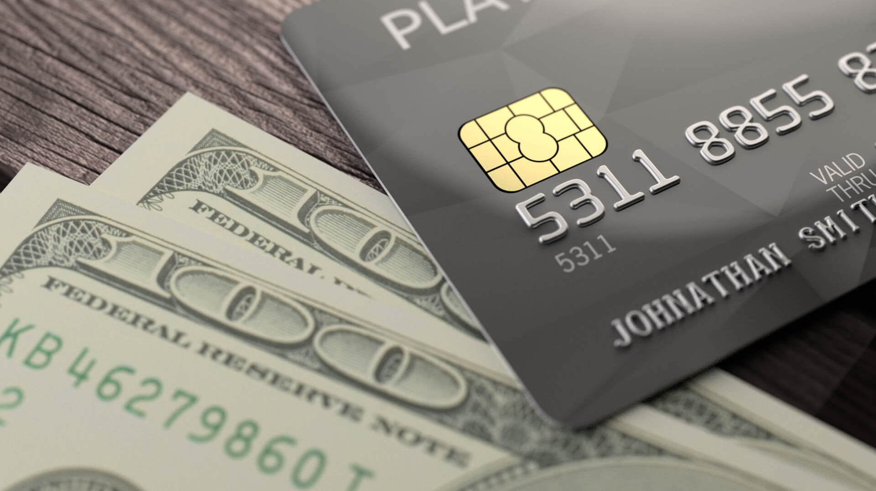
THANK YOU
This Photo by Unknown author is licensed under CC BY-ND.

